Slide 1

Diabetes Prediction
From Patient Health Indicators
By: Justin Ku

Slide 2

Introduction:
Diabetes is a serious chronic disease that plagues millions of lives each year
What health indicators determine Diabetic vs. non-Diabetic?
Can a model be made to predict Diabetes diagnosis or likeliness?

Slide 3
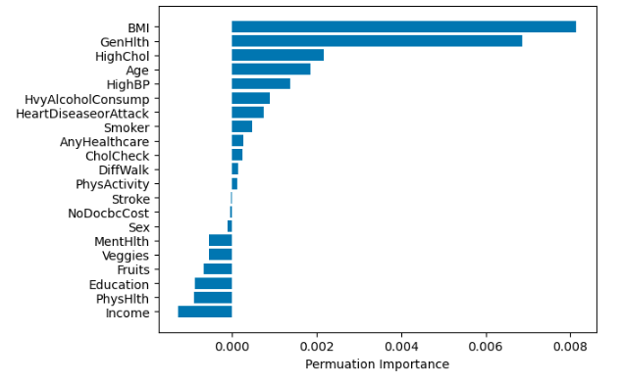
Important Health Indicators:
What indicators correlate with a Diabetes diagnosis?
BMI
General Health
High Cholesterol

Slide 4

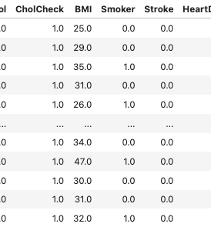
Data Used:
Cleaned data taken from Public Health Surveys by the BRFSS (Behavioral Risk Factor Surveillance System)

Slide 5

Data Wrangling:
Dataset contains 253,680 rows and 22 columns (features)
No Null values or Dirty Data to account for
Target feature column changed to “DiabetesDiagnosis”

Slide 6
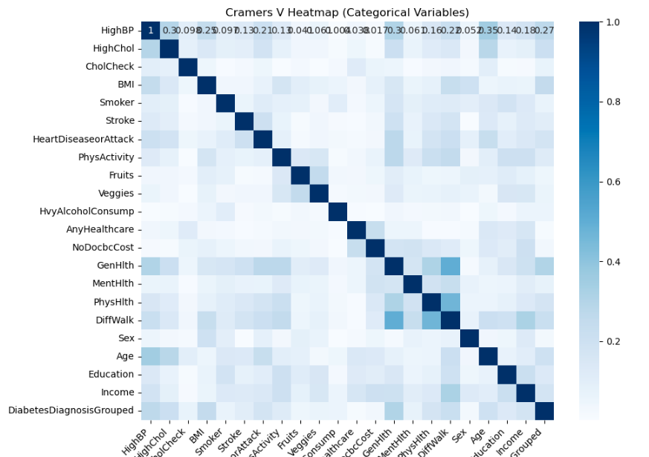
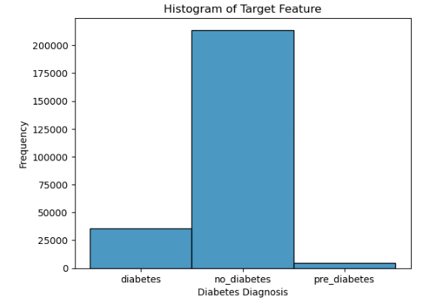
Exploratory Data Analysis

Slide 7
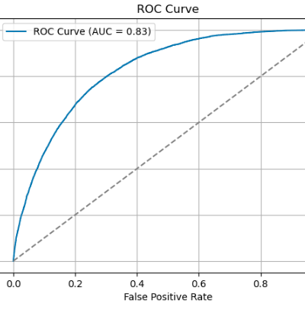
Model Selection:
3 model types were compared
XGBoost
KNN
SVM

Slide 8
Takeaways:
XGBoost model performed the best
Highest Recall
Highest F1 Score
Highest AUC Score
Recall is important in diagnosis
Missing a Diabetes diagnosis has disastrous future health outcomes

Slide 9
Future Improvement:
Expand to more granular health parameters
Data balancing
Use a more balanced dataset (Diabetic vs. Non-Diabetic)
Model Hypertuning
Further tune the XGBoost model to get better predictions

Slide 10
Thank You!

